Slide 1


+
Your HSA or FSA May Cover More Than You Think
Use pre-tax dollars for eligible health interventions tied to prevention, treatment, or mitigation of certain medical conditions.

Slide 2

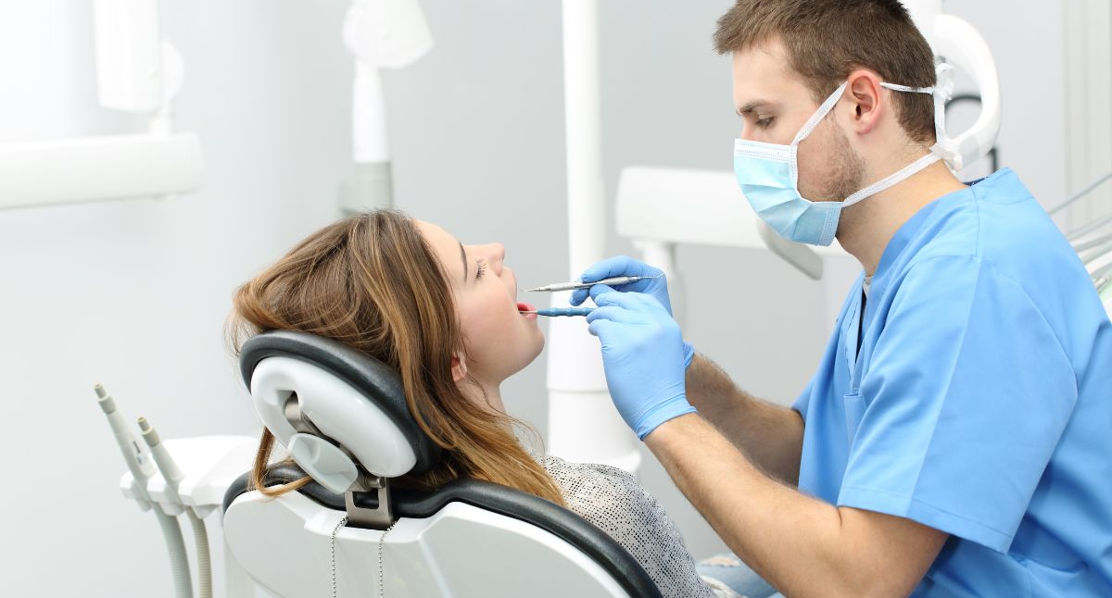


Most People Only Use Their HSA or FSA
for Traditional Expenses
+
Examples:
Doctor visits
Prescriptions
Copays
Dental and vision expenses
But under IRS guidelines, certain additional health interventions may also qualify when recommended by a licensed practitioner and supported by a Letter of Medical Necessity.

Slide 3
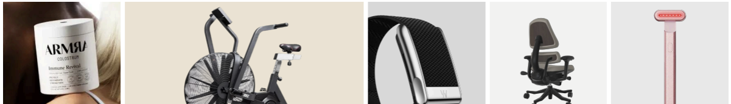
What Might Qualify?
And Why This Matters?
+
Most People Only Use Their HSA or FSA for Traditional Expenses
Potential eligible categories
may include:
Fitness equipment, sleep support tools. recovery and mobility devices, red light therapy, health tracking devices, adaptive footwear, weight management support
Other evidence-based interventions
The Benefit to You
Use pre-tax HSA or FSA dollars
Save approximately 30% through tax advantages
Invest in tools that support long-term health goals
Connect benefits to real everyday needs
Eligibility is based on individual medical need and practitioner approval.

Slide 4




How it Works
A Simple, Guided Process
+
Browse
Explore products and services that may be eligible for
HSA/FSA use.
Choose
Shop directly from participating brands
and add items to
your cart.
Qualify
Complete a quick health survey for review by a licensed provider.
Pay
If approved, receive a
Letter of Medical Necessity and complete your purchase using
HSA/FSA funds.
To remain aligned with IRS guidelines, purchases require practitioner review and eligibility is based on individual medical needs. Be sure to retain your documentation in case it is needed for substantiation.

Slide 5

Think Ahead When
Choosing Your Contributions.
+
Planning ahead during Open Enrollment can help maximize your tax savings throughout the year.
If you are considering a larger eligible purchase next year, Open Enrollment is a good time to review your HSA or FSA contribution amount.

Slide 6
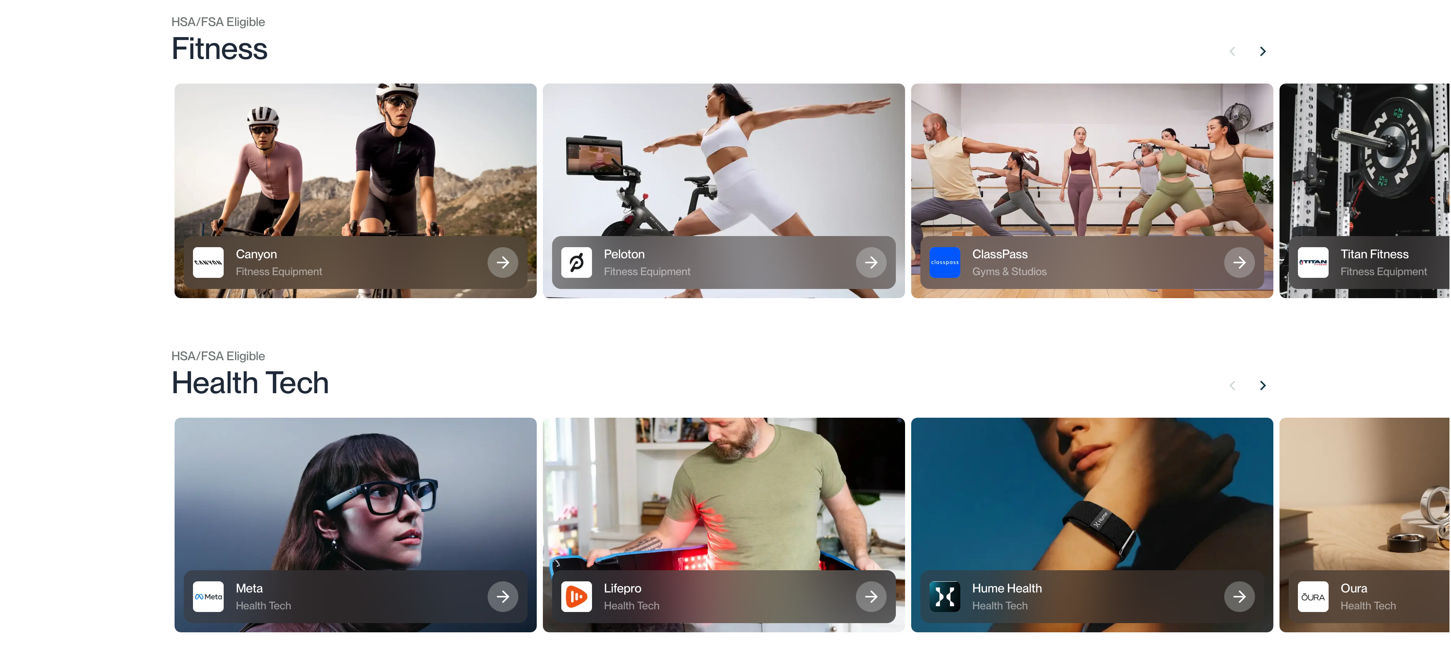
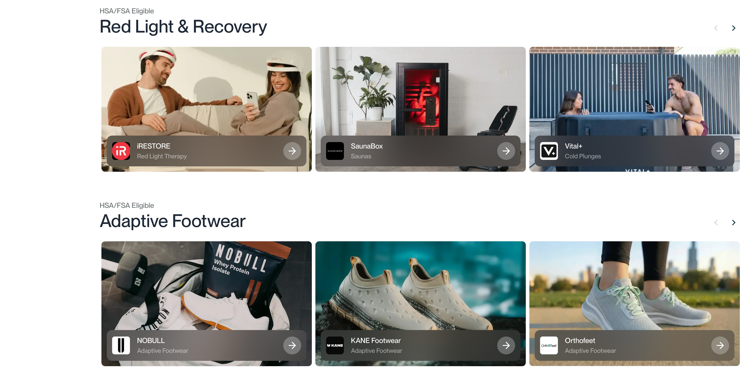
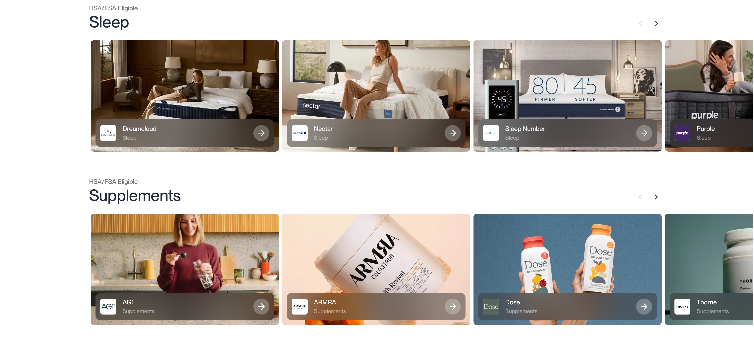
Make the Most
of Your Benefits
Explore eligible products and learn more:
www.truemed.com/a/clarity-benefit-solutions

Slide 7
Thank You

